Slide 1

Voluntary Carbon Markets 101
Kelley Hamrick,
Forest Trends’ Ecosystem Marketplace
April 2, 2019

Slide 3
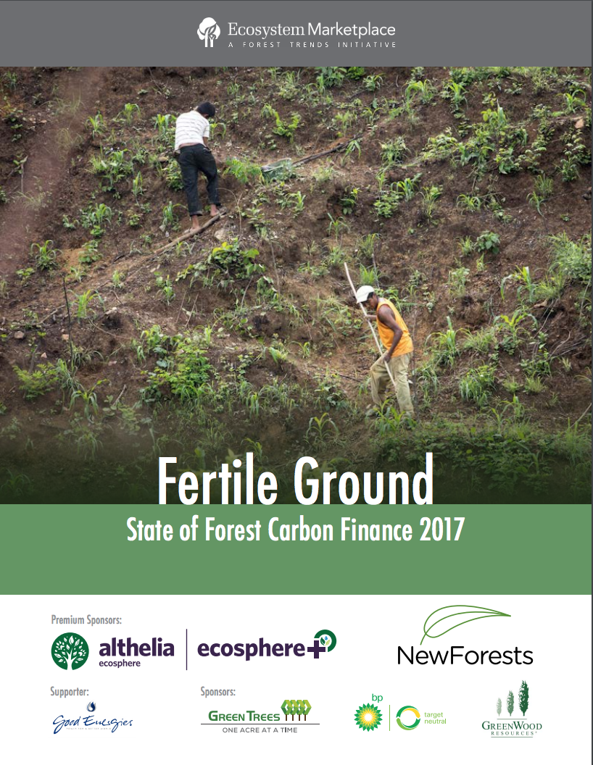
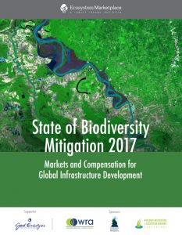
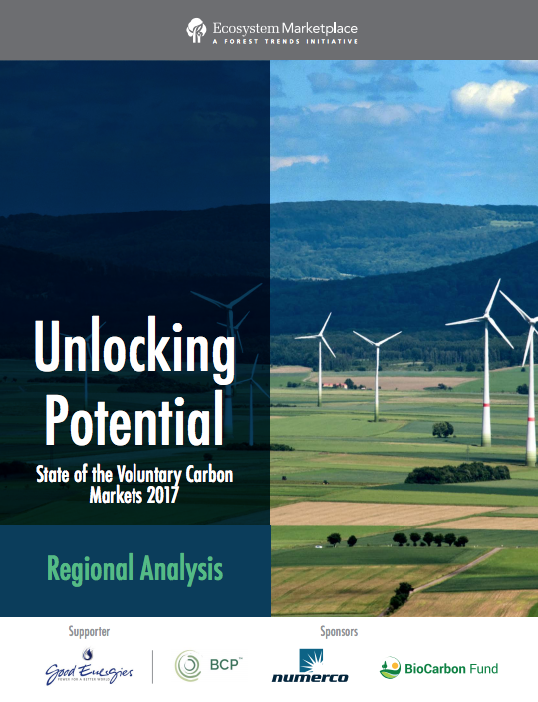
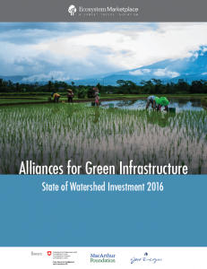
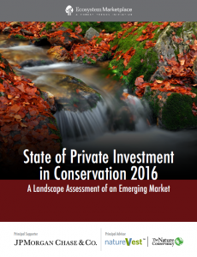
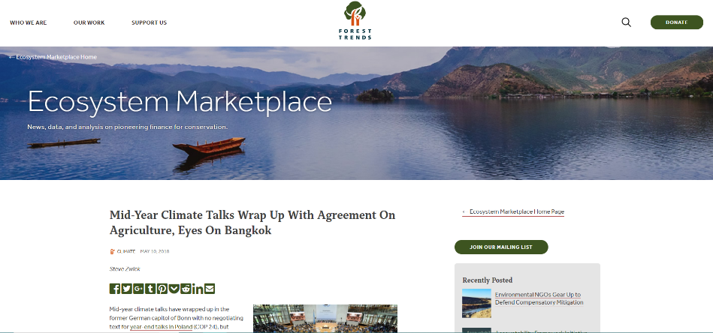
Who is Ecosystem Marketplace?
Forest Trends’ Ecosystem Marketplace Initiative is the leading global source of information on environmental finance, markets, and payments for ecosystem services.
https://www.forest-trends.org/ecosystem-marketplace
@foresttrendsorg
@EcoMarketplace
Notes:
Many of you may be familiar with Ecosystem Marketplace’s work. We produce annual reports on environmental markets including water, biodiversity, the voluntary carbon and forest carbon markets. We also write articles that cover the latest policies, financing and project development in these markets. All of our articles and reports are freely available on our website.

Slide 4
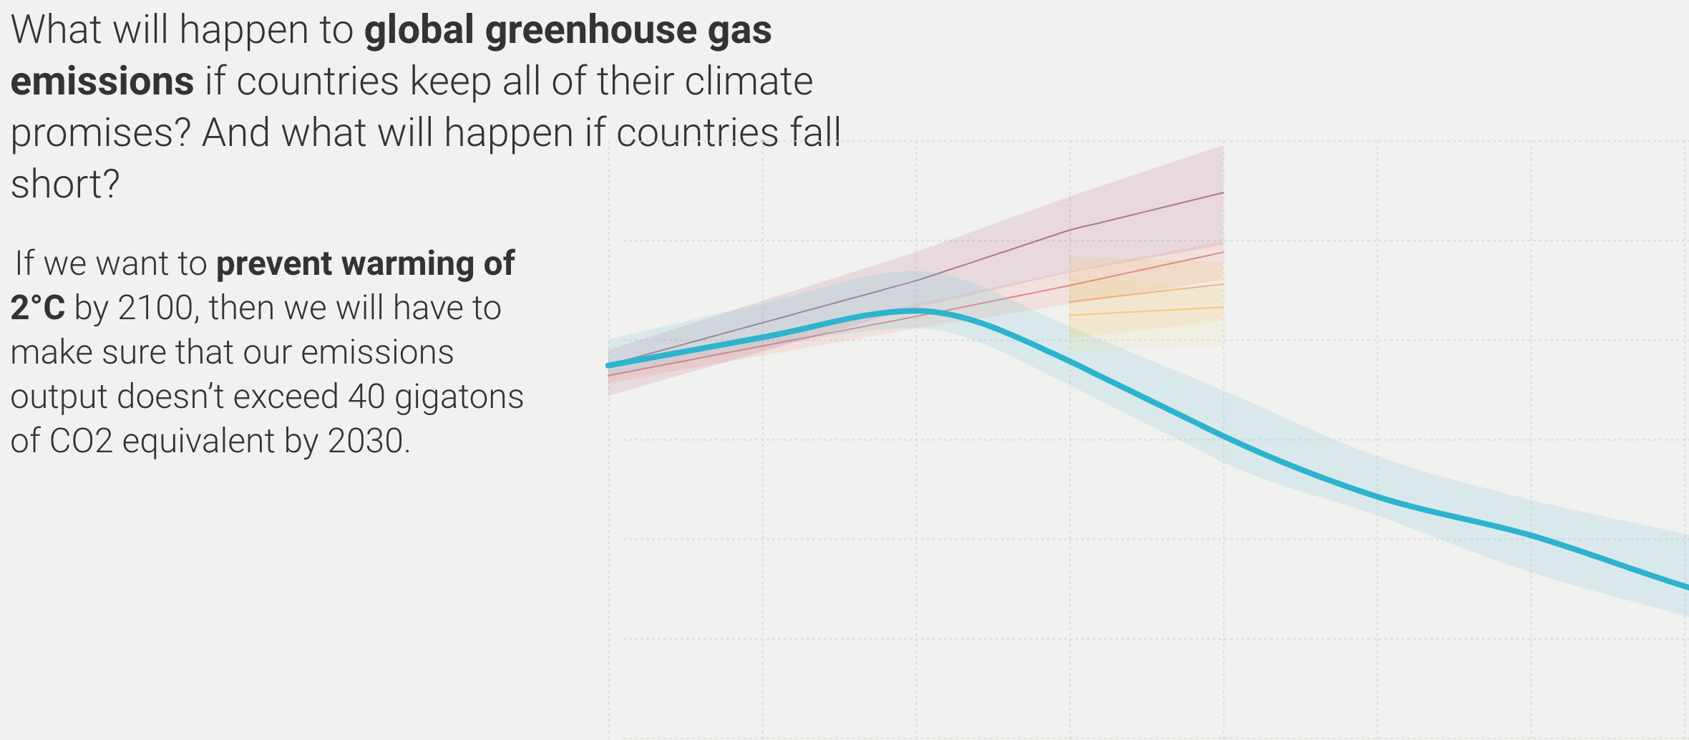
We are not on track to reduce emissions
https://www.unenvironment.org/interactive/emissions-gap-report/
Notes:
As you all know, we are not on track to reduce emissions
This is largely due to countries not setting or implementing stringent targets, policies and mechanisms

Slide 5
How do offsets fit in?
Compliance markets – markets regulated by a government – often allow a percentage of emissions reductions to occur through offsets.
Voluntary markets occur when corporations, individuals, governments and others purchase offsets to go above and beyond their own emissions reductions activities.
Many of these offsets also have sustainable devlopment benefits.
@foresttrendsorg
@EcoMarketplace
Notes:
We need deep emissions reductions within all industries and countries in the world.
Some emissions reductions are easier and most cost-effective to implement than others.
A carbon offset represents a tonne of carbon dioxide – or equivalent greenhouse gas – reduced, sequestered or avoided. These emissions reductions can be quantified & traded around the world
For example, in a compliance market like California, …

Slide 6


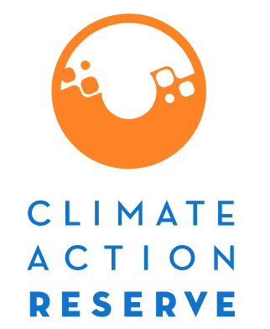


Attributes of an offset
P
A
V
E
R
ERMANENT
DDITIONAL
ERIFIABLE
NFORCEABLE
EAL
@foresttrendsorg
@EcoMarketplace
Notes:
In the past, organizations might do an activity and then say how many emissions reductions they thought they made. Historically, projects producing voluntary carbon offsets were unregulated. In some cases, project developers said that they had reduced emissions, when researchers or activities later found that in fact no emissions reductions had taken place. Because of this and other quality concerns, third-party voluntary offset standards made requirements to ensure that offsets approved under their standard represent real emissions reductions.
Nowdays, nearly all voluntary projects are developed in accordance with methodologies or protocols made by third-party standards – who lay out rules and regulations, and ensure activities are verified by third-party auditors.
In 2016, 99% of offsets in the voluntary carbon markets were certified by a third-party
And respondents reported using thirteen different standards – major ones shown here on the right
Most standards seek to ensure the following for any approved offsets::
Permanent, Additional, Verifiable, Enforceable, and Real

Slide 7
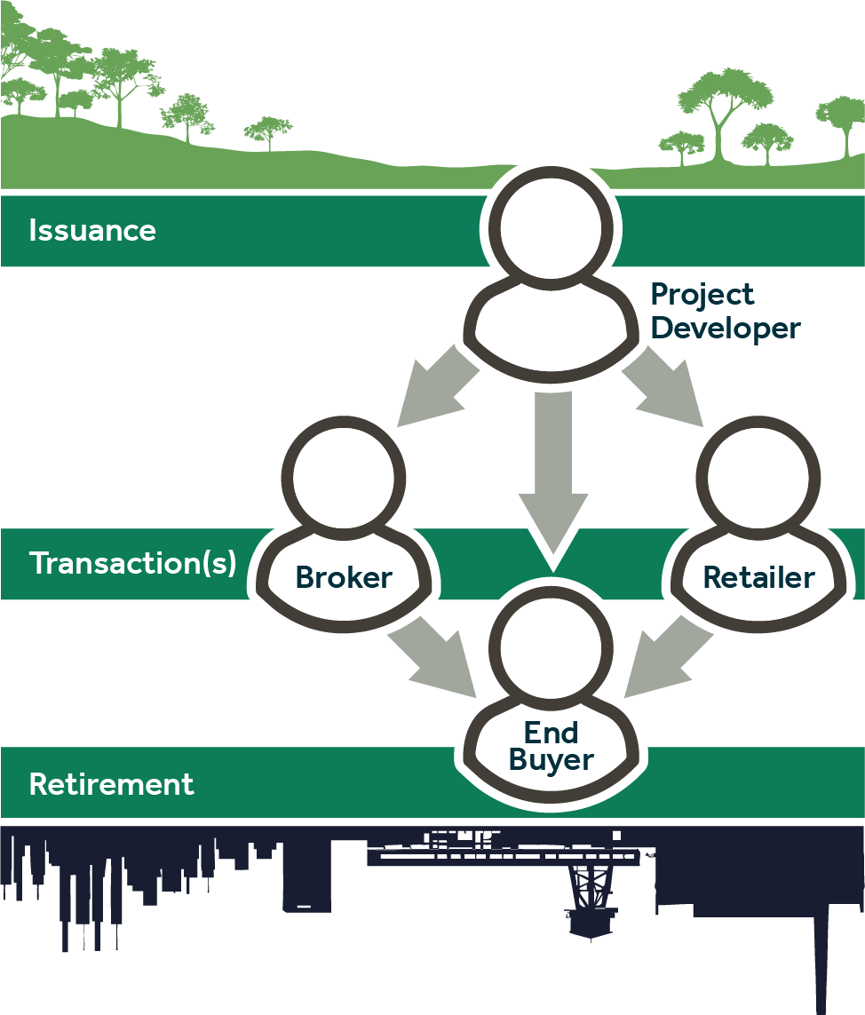
How is a voluntary carbon offset produced?
@foresttrendsorg
@EcoMarketplace
Notes:
The top part of the slide shows possible stages of voluntary offsets (Please keep in mind that the specific steps may vary, depending on what standard a carbon project follows.)
Before an offset can be traded, or transacted, it first must be produced. Offsets are produced by projects – the first five bullet points listed here reflect steps most projects go through to produce an offset:
Generally, a project developer begins by outlining what they expect a project will do in a project idea note.
Following that, they will select a methodology (which includes more specific rules about next steps), and then detail what they will do in a project design document.
A third party organization – not the standard body or the project developer – will then validate that the project is meeting all of the requirements for a standard body’s methodology.
Once the project has started to achieve its emissions reductions goals, the a third party will visit the project again to verify the number of emissions reductions a project has achieved.
At that point, the standard bodies will issue offsets to the project developer. These offsets appear on what’s called a registry; and each offset is given its own unique ID.
This can sometimes take years, but it’s not even the most difficult part.
The most difficult part for some PDs is selling their offsets.
After issuance, emissions reductions are tradable…
However, no centralized marketplace for buyers and sellers to meet.
This is what we track – transactions. Here are some of the different ways an offset can change hands before being retired.
PD to End Buyer
PD to broker
PD to retailer
Retirement is when an end buyer wants to use the offset to count against its own emissions reductions. This is a critical step because it flags offsets on the registry as being permanently sold. That way no other organizations can count the emissions reduction as their own.

Slide 8
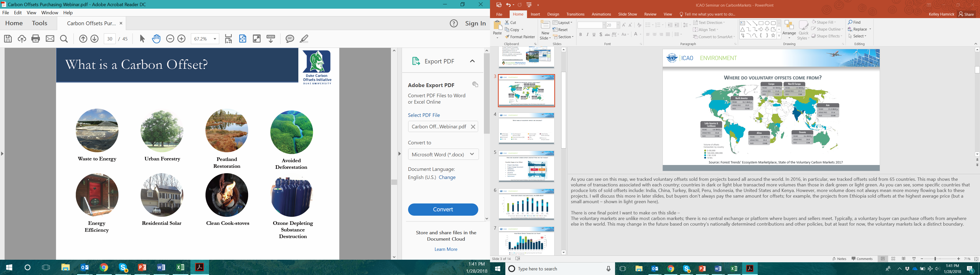
What kinds of voluntary offsets are there?
Project Types:
Waste to Energy
Peatland Restoration
REDD+
Energy Efficiency
Clean Cookstoves
Ozone-Depleting Substance Destruction
@foresttrendsorg
@EcoMarketplace
Notes:
Emissions reductions can occur from a variety of activities, such as installing more efficient light bulbs to planting trees.

Slide 9
What kinds of voluntary offsets are there?
 | # of Active Projects | Offsets Issued (2005- 03/2018)
Agriculture (livestock methane, no-till/low-till ag, etc.) | 86 | 6.7 MtCO2e
Chemical Processes and Industrial Manufacturing (ozone depleting substances, nitric acid, etc.) | 33 | 52.8 MtCO2e
Energy Efficiency and Fuel Switching (waste heat recovery, coal mine methane, energy efficiency, etc.) | 649 | 135.4 MtCO2e
Forestry and Land Use (REDD+, IFM, wetland restoration, etc.) | 155 | 94.2 MtCO2e
Household Devices (clean cookstoves, water purification, etc.) | 161 | 23.4 MtCO2e
Renewable Energy (wind, solar, hydro, etc.) | 606 | 61.7 MtCO2e
Transportation (carpooling, mass transit, vehicle electrification, etc.) | 43 | 1.1 MtCO2e
Waste Disposal (landfill methane, waste water methane) | 236 | 57.3 MtCO2e
@foresttrendsorg
@EcoMarketplace
Notes:
An offset represents a tonne of carbon dioxide – or equivalent greenhouse gas – reduced, sequestered or avoided. These emissions reductions can occur from a variety of activities, such as installing more efficient light bulbs to planting trees.
As you can see, the majority of actively-issuing projects are those doing energy effiency & fuel switching activities, followed by renewable energy, waste disposal, and then forestry and land-use. However, these projects might have different amounts of actual impact, so the offsets issued is different – EE & Fuel switching is still the largest, but then followed by forestry, and then chemical processes & industrial manufacturing.
# of new projects coming online – still a lot for EE & fuel switching, and reneable energy.
Project category with most retirements – EE& fuel switching (63%), followed by household devices (61%)
Lowest % retirement is chemical processes (18%)
Notes on the data:
The number of active projects refers to any projects that have issued offsets on the voluntary market.
All data in this table are based on information from four standards: the American Carbon Registry (ACR), the Climate Action Reserve, the Gold Standard, and Verra’s Verified Carbon Standard (VCS).
Here we are defining “New Projects” as projects that issued their first offsets Q1 of 2018

Slide 10
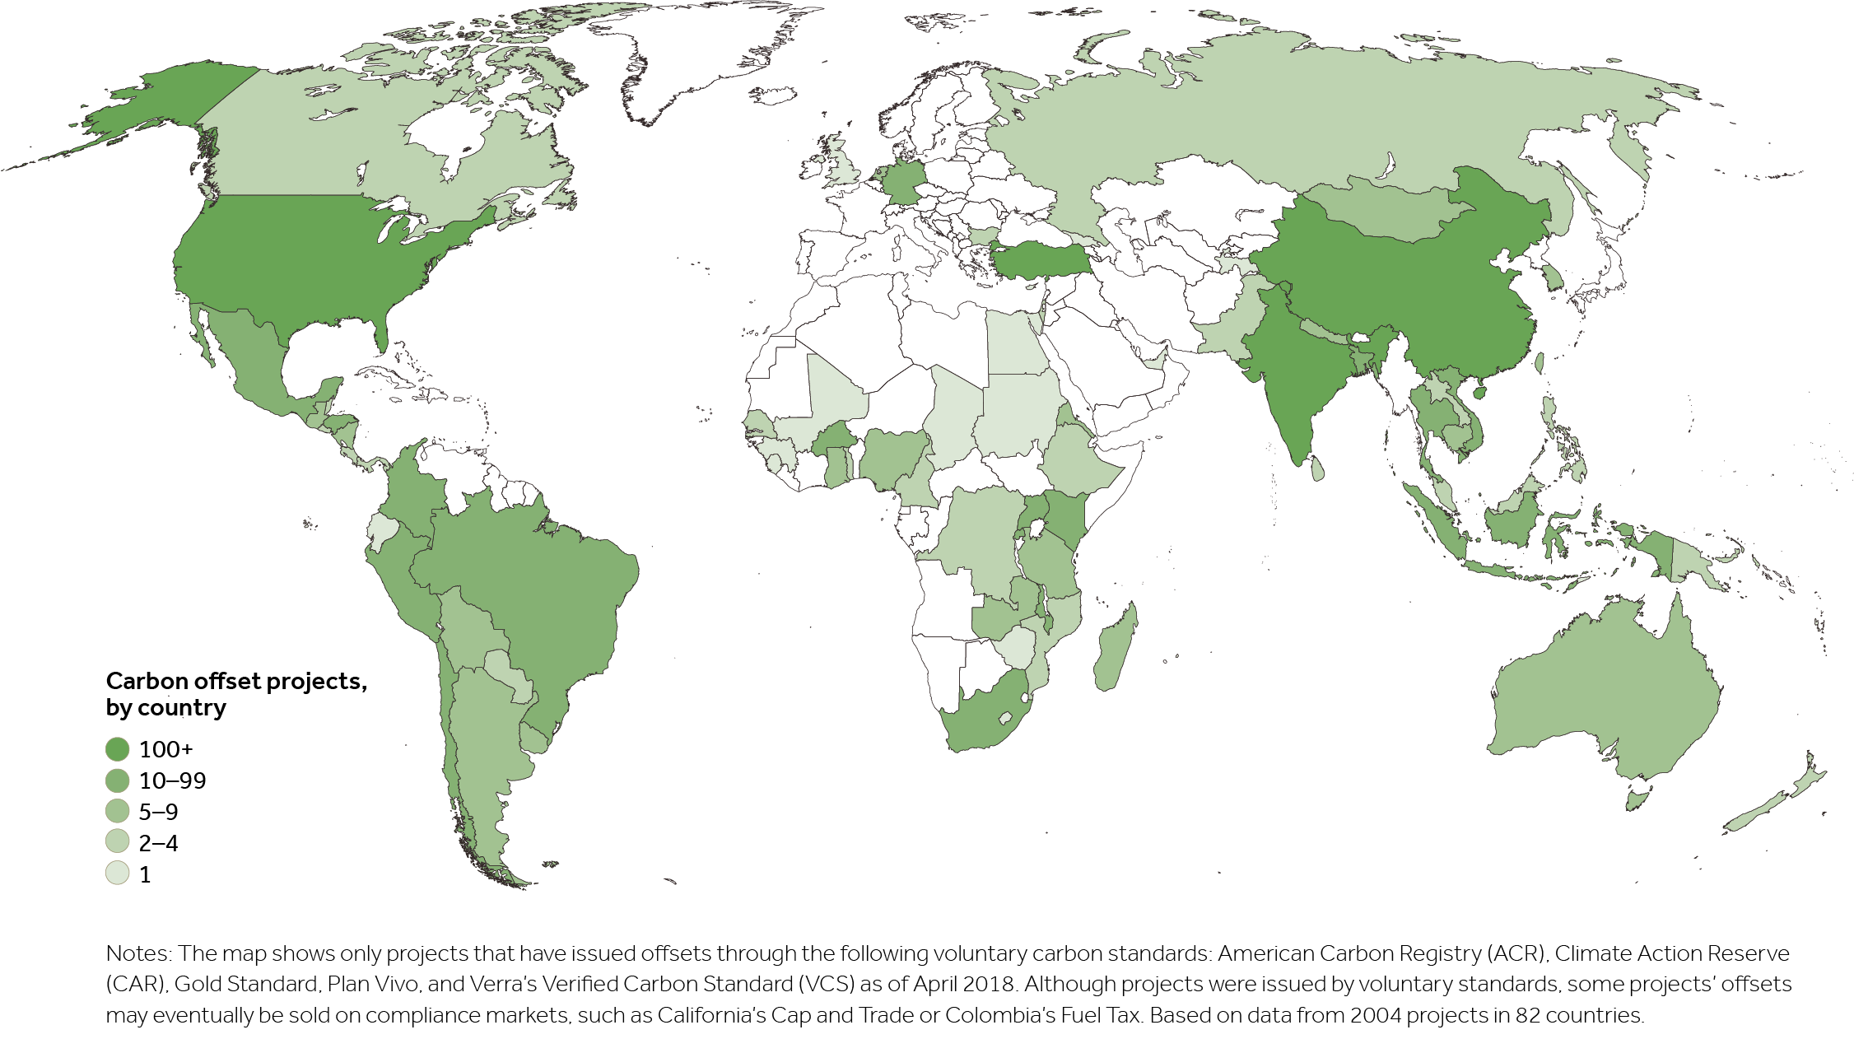
Where are voluntary carbon projects located?
@foresttrendsorg
@EcoMarketplace
Notes:
As you can see, offset projects are based all over the world
As you can see, some specific countries that produce lots of sold offsets include: India, the United States, Brazil, Peru, Turkey, Kenya, China and Indonesia. However, more volume does not always mean more money flowing back to these projects. I will discuss this more in later slides, but buyers don’t always pay the same amount for offsets; for example, the projects from Ethiopia sold offsets at the highest average price (but a small amount – shown in light green here).
There is one final point I want to make on this slide –
The voluntary markets are unlike most carbon markets; there is no central exchange or platform where buyers and sellers meet. Typically, a voluntary buyer can purchase offsets from anywhere else in the world. This may change in the future based on country’s nationally determined contributions and other policies, but at least for now, the voluntary markets lack a distinct boundary.
Most forestry projects in…
US – 37
Brazil – 14
Peru – 8
Colombia – 7
Kenya – 6
All others 5 or less
Biggest issuances from projects in…
Indonesia (4 projects)
DRC (4 projects)
Peru (8)
US (37)
Colombia (7)

Slide 11
Climate impact of voluntary offsets
From 2000 - 2018, voluntary carbon projects have helped to reduce, sequester, or avoid over 432.6 MtCO₂e.
@foresttrendsorg
@EcoMarketplace
Notes:
Offset transactions, issuances, and retirements are all important metrics for market size – but none of them is a comprehensive indicator of the overall emissions reductions achieved as a result of the voluntary market
We included this as best proxy for trying to show climate impact of total market.
Across all time, voluntary carbon projects have helped to reduce, sequester, or avoid over 416.2 MtCO₂e. an amount that could more than neutralize Australia’s annual emissions
Last year’s annual issuances totaled 62.7 MtCO₂e: a record high for the market. That is the equivalent of not consuming almost 150 million barrels of oil.

Slide 12
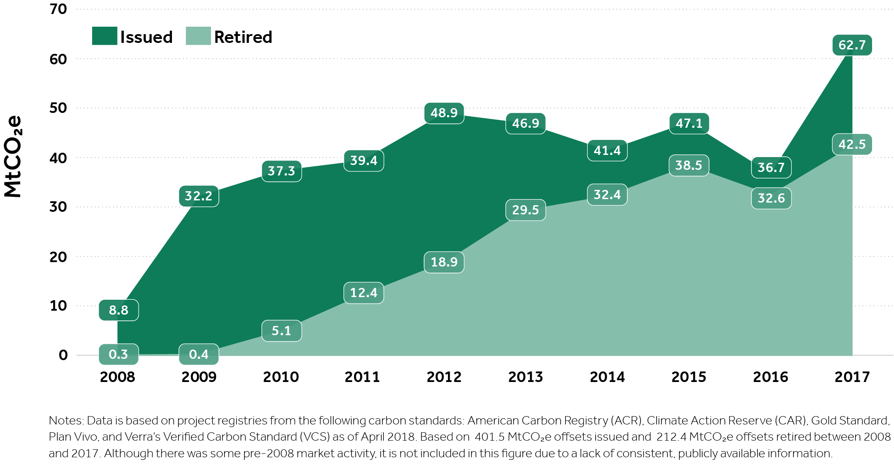
Historical voluntary carbon offset issuances and retirements
Notes:
Since 2005, voluntary carbon projects have helped to reduce, sequester, or avoid over 435.4 MtCO₂e–which is more than all of Australia’s energy-related emissions in 2016. Last year alone, projects issued 62.9 M offsets: a record high for the market. That is the equivalent of not consuming almost 150 million barrels of oil.
Key findings:
2017 saw a record high of issuances (62.9 MtCO₂e) and retirements (42.8 MtCO2e) WOO
2017 Retirements:. Most came from VCS projects, followed by Gold Standard, CAR projects, ACR projects, and Plan Vivo projects
Speculation: US paris agreement? Companies looking more at Scope 3?
In general, the total amount of issuances has increased year over year, but a particularly large uptick occurred last year
Some of the historic variation year to year can be attributed to activity in compliance markets.
FORESTRY:
Issuances: 30.7 Mt = record high in 2017
Q1 already 10.9 Mt
Retirements: 12.3 Mt = record high in 2017
Q1 already 6.7 Mt

Slide 13
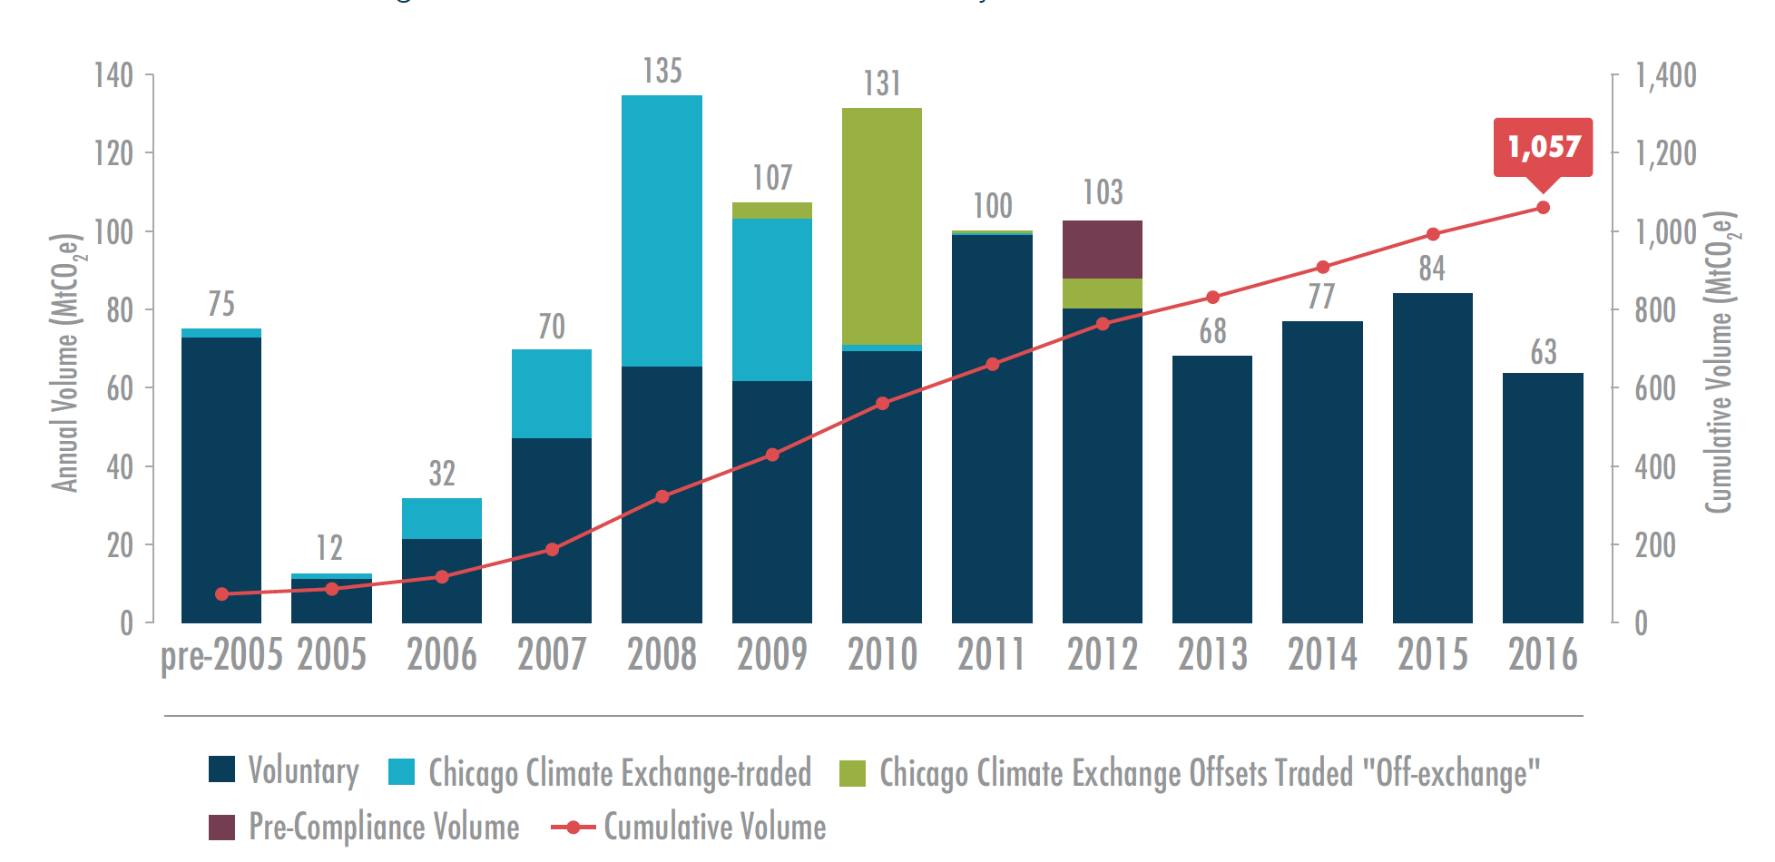
Historical voluntary offset transaction volumes
Source: Forest Trends’ Ecosystem Marketplace, State of the Voluntary Carbon Markets 2017
@foresttrendsorg
@EcoMarketplace
Source: Forest Trends’ Ecosystem Marketplace, State of the Voluntary Carbon Markets 2017
Notes:
In terms of transactions… remember can be double counting of specific offsets here!...
Going to look at what is happening in between issuances & retirements.
The red line shows CUMULATIVE volume; you can see we’ve topped the 1 billion tCO₂e in offsets transacted.
In 2016 alone, we tracked a total of 63.4 million (M) tons of carbon dioxide equivalent– a 24% decrease from 2015 but
You can see in the chart that voluntary transactions have always varied year-over-year.
A key factor in the “high” volumes seen here was from the interaction between the voluntary and compliance markets.
Policy decisions can play a big signal in the market…
Ex: light blue color shows one category tracked – the Chicago Climate Exchange. That was a big player – established in the U.S. in 2003 as a voluntary GHG emissions reduction program that evaporated when the likelihood of a US compliance program vanished in 2009.
Will see in the next slide how important long-term, stable policy is to the markets
For example, when California introduced its cap-and-trade program in 2013, it allowed some United States (US) voluntary offsets and voluntary projects to convert into compliance offsets. (maroon color, 2012)

Slide 14
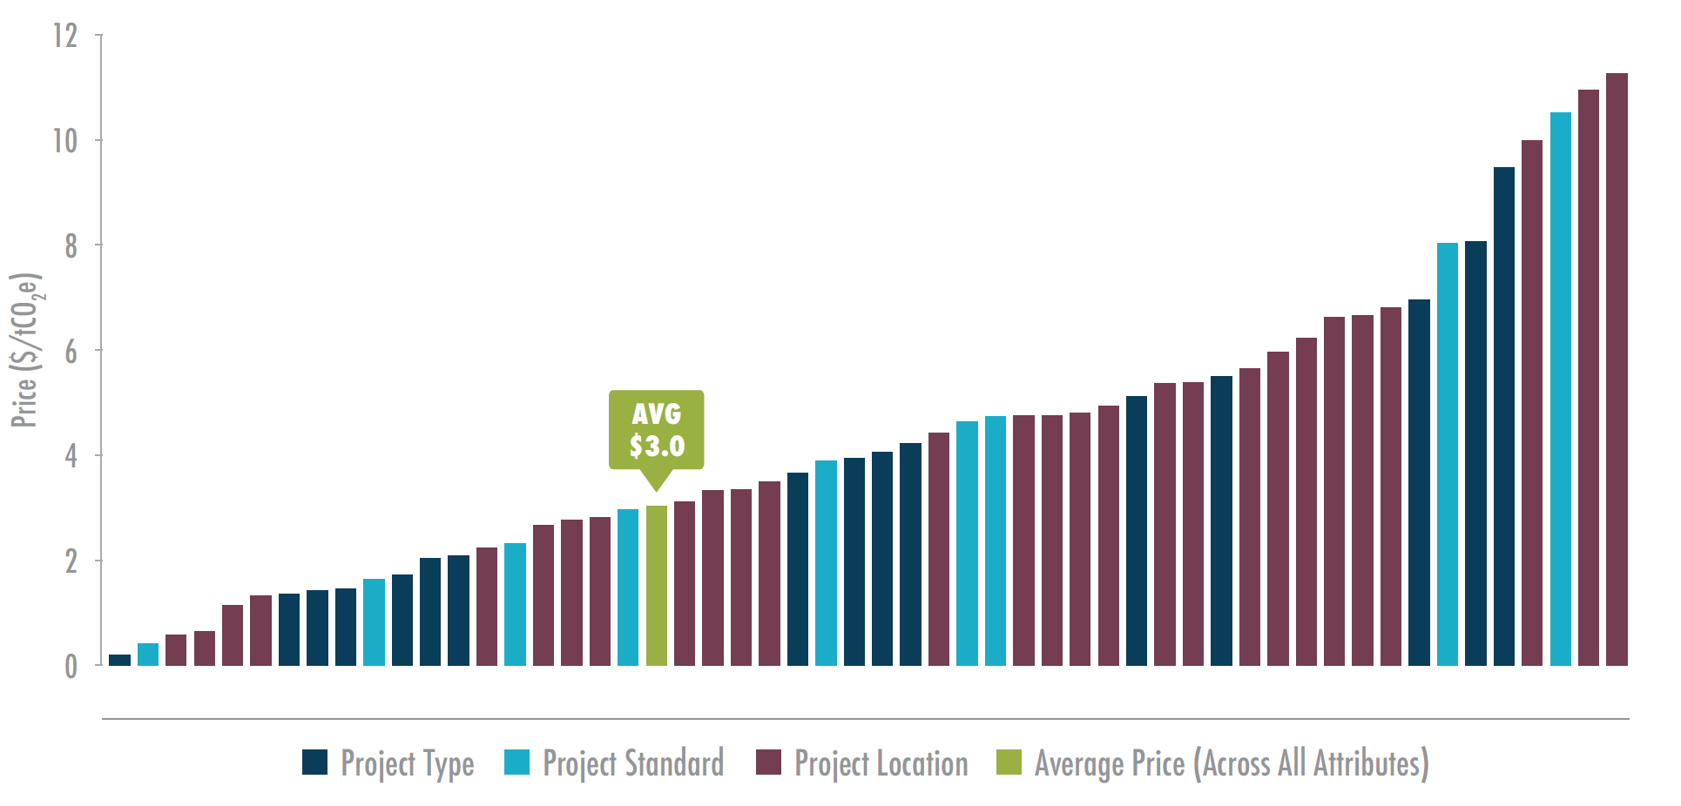
How are prices determined?
Ethiopia
$11.3/t
Plan Vivo
$8.0/t
Clean cookstoves
American Carbon Registry
$5.1/t
$4.7/t
China
$2.2/t
Large hydro
$0.2/t
Source: Forest Trends’ Ecosystem Marketplace, State of the Voluntary Carbon Markets 2017
@foresttrendsorg
@EcoMarketplace
Notes:
Actual prices from less than $.5 to more than $50
A number of reasons, include project type, standard & location
Project type: Startup and operating costs differ based on how the offsets are being produced.
Project location: Costs for land, staff, and other factors vary by location.
Transaction size: Larger transactions sizes often correspond with lower prices.
Who’s buying: Intermediary sellers often pay lower prices than end buyers.
Buyer’s preferences: Some buyers choose offsets based primarily on the cost, while others pay more to source offsets from certain project types or locations, or with certain co-benefits
(shown later)
Speaking of value… what determines prices anyway?
Prices remained highly variable- and differed based on particular location, standard, project type, or other attributes.
Prices ranged from less than $0.50/tCO₂e to more than $50/tCO₂e.
The average price across all transactions was $3.0/tCO₂e.
Lowest: large hydro @ $0.2/t
Highest: Ethiopia @ $11.3/t
There are a number of factors that affect average price; include which standard is used, which methodology/project type, project finance, location, and buyer motivation. We’ll touch on some of these in the coming slides

Slide 15
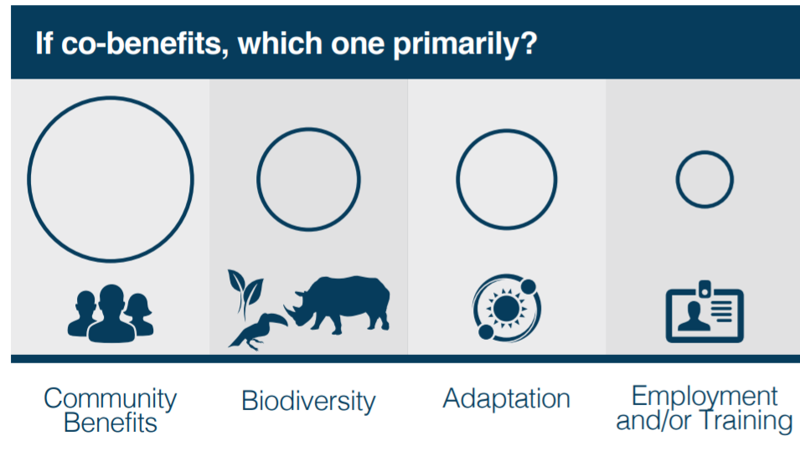
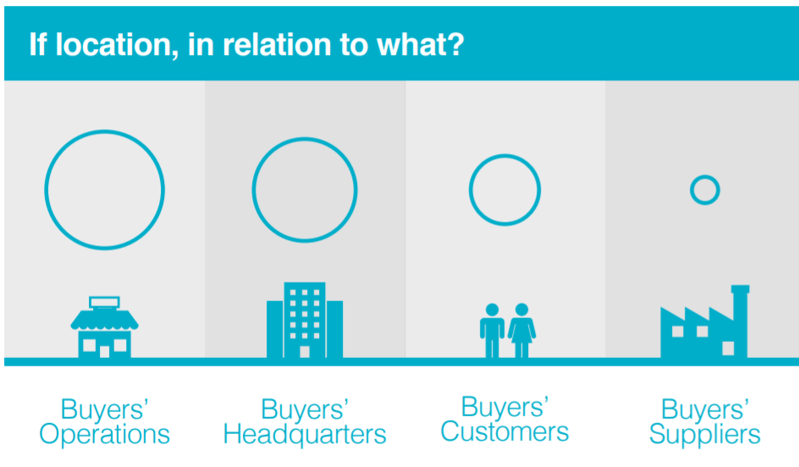
Another differentiator: co-benefits and location, location, location
Source: Forest Trends’ Ecosystem Marketplace, State of the Voluntary Carbon Markets 2017
@foresttrendsorg
@EcoMarketplace
Source: Forest Trends’ Ecosystem Marketplace, State of the Voluntary Carbon Markets 2017
Notes:
Other factors that might influence demand for offsets include…
Mentioned previously, co-benefits and project location.
we asked respondents (suppliers) what reasons *they thought* buyers purchased their offsets.
You can see here…

Slide 16
Upcoming trends
Paris Agreement decisions
CORSIA
Insetting / internal climate investments
Quantification of non-carbon benefits
“Innovative” offsets
Source: Forest Trends’ Ecosystem Marketplace, State of the Voluntary Carbon Markets 2017
Notes:
There are some upcoming trends that can inhibit, change, or expand voluntary
Paris Agreement: depending on how the rules go, this could severely curtain voluntary offsetting
CORSIA could become the world’s largest carbon market: it could potentially create demand for 1.6-3.7 billion tonnes of emissions reductions during its initial three phases of implementation.

Slide 17




Notes:
A few interesting things coming up include…

Slide 18
THANK YOU
Kelley Hamrick
khamrick@ecosystemmarketplace.com

